Slide 1
Things to consider before analyzing your data:
Thoughts from your local statistics team
Rebecca Koscik
Carol Van Hulle
Derek Norton
Erin Jonaitis
Yue Ma
Rick Chappell

Slide 2
Outline
Context of our presentation -- Rebecca Koscik
Key points related to research ethics and quality – Carol Van Hulle
Data Analysis Plans (and related) – Derek Norton
Multiple Comparisons – Erin Jonaitis
General do’s and don’ts examples – Yue Ma
Example of a study that ties pieces together – Rick Chappell
Summary/Conclusions/Resources

Slide 3

Context of our presentation
AD research program embraces practice of “Team Science”:
…collaborative,
… brings together the strengths and expertise of
professionals trained in different fields.
Working together to leverage expertise will maximize quality
of our contributions to science.

Slide 4
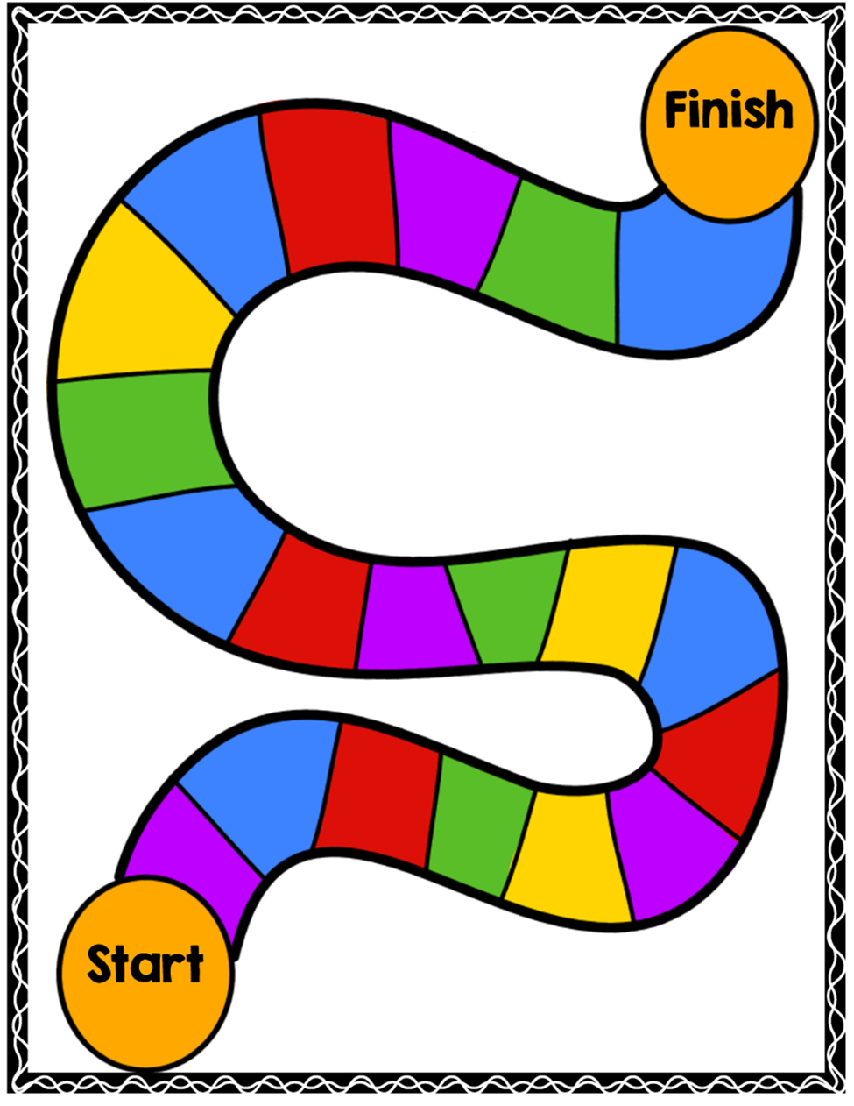
Context (continued)
Running models and looking at p-values
related to hypotheses is near the end of
long sequence of important steps in
conducting high quality investigations
addressing specific research questions.
Notes:
I’ll turn it over now to my colleagues to share some of their expertise related to steps on the way to a scientifically solid manuscript or grant proposal or conference presentation.

Slide 5
Research ethics and quality
Carol Van Hulle
Notes:
I’ll be recapping Lindsey’s talk on from last Spring on Research Ethics.

Slide 6
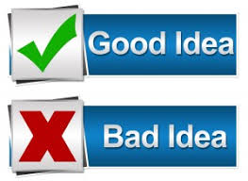
Research
practices
Science
Research
practices
Science
Notes:
I like to think of it as doing good science and avoiding bad science, which often boils down to engaging in good research practices and avoiding bad research practices.

Slide 7

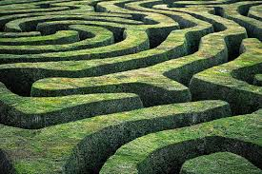
Bad research practices ≠ bad people
“The garden of forking paths” - Andrew Gelman
Researcher degrees of freedom
Notes:
Bad research does not necessarily come from bad people. We’re not discussing fraud today.
Does anyone know who this is? Its Andrew Wakefield who claimed to find a link between vaccines and Autism, which led to a lot of wasted research dollars because in reality falsified his data That’s not the kind of ethics or best practices that we are talking about today.
Today we are focusing on what Andrew Gelman calls the garden of forking paths and others refer to as researcher degrees of freedom. When we do research we have a lot of decisions to make at every step of the way, and how we make those decisions can have a big impact on the quality of the research that we produce. Science is hard and even well-meaning people can develop bad habits or make poor decisions.

Slide 8
Lots of data +
Lots of possibilities for interesting relationships to be examined +
Publish or perish incentive system =
Good intentions gone awry
Notes:
Especially in our situation. We have lots of data, a large number of potentially interesting relationships and an incentive system that rewards publication which can lead to good intentions going haywire.
Lindsey included this quote in her presentation, <read> but I don’t think we have to stop, we just have to be more careful.

Slide 9
Good scientific practices lead to research that is…
Replicable
Reproducible
Robust
Ability to implement the methods as exactly as possible.
Ability of others using similar methods to get similar results
Ability of others using not so similar methods to get similar results
Notes:
Good scientific practices help us produce research that is replicable, reproducible and robust. These terms don’t have hard and fast definitions but I think these are defensible.
Replicability I think of as internal, that is your lab-mates and even your future self should be able to follow what you did and get the same results. IF a reviewer asks for something you should be able to go back and recreate yoru analyses and your sample.
Reproducibility refers to getting the same results using similar methods.
Robust research is the holy grail, we want our research to eventually lead to real answers. valid explanations for how people develop AD for example.

Slide 10
Good scientific practices avoid…
p-hacking
Hypothesizing After the
Results are Known
Bias/Chance
i.e. picking the best possible results out of several or picking set of comparison based on your data
“There are two possible articles you can write: (1) the article you planned to write when you designed your study or (2) the article that makes the most sense now that you have seen the results. “ Bem, 1987.
Reproducibility/robustness relies on avoiding chance findings
Goodman, Fanelli, Ionnidis, 2016
Notes:
That’s the kind of research we want to produce. In order to do that we want to avoid some common pitfalls, like
p-hacking: p-hacking sometimes refers to writing up just the best results from your analyses instead of writing up all your results. Gelman & Loken argue that a kind of p-hacking occurs when you have a large set of possible comparisons and you pick your analyses based conditional on your data. When you have a large number of potential comparison its important to think through ahead of time what you want to look at. Otherwise you might introduce bias into your analyses
HARKing – is creating or modifying your hypothesis after you see the results
In general we want to avoid analyses that are biased or capitalize on chance if our results are going to be reproducible or robust.

Slide 11
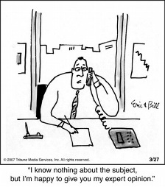

START with a question
What are good
Research practices?
Specific and
Testable
Ground your
question in
existing theory
Notes:
What are good research practices?
Start with a question – It might seem obvious, but its something that’s actually easy to rush through when you have data in hand.
An effective research question is specific enough to generate a testable hypotheses; Gelman & Loken warns against forming research questions that are so broad that any comparison and any result can be justified as supporting your hypothesis.
Your question should be grounded in existing theory or research.

Slide 12
START with a question
Revisit the question.
Does your approach
still answer it?
Really plan
Ahead
What are good
Research practices?
Keep a record of your analyses
Determine approach (keep it simple)
Check your data quality
Check your
assumptions
Discuss your approach/
analysis with others
Notes:
Plan ahead, give yourself plenty of time to really think about your approach before you start. What does the literature say? What is your hypothesis? What is your conceptual model? Derek is going to go through a statistical analysis plan
3. Determine approach based on your questions, not on your software. Keep it as simple if you can. We are studying complex processes that require some pretty sophisticated analyses, but they should be used when you need them, not because its sexy.
4. Discuss your approach/analysis idea with statistician + other scientists you don’t have to do this alone.
5. Know your data – this is another practice that seems obvious, but can get short shrift in practice. Know what the values mean, check for errors. Data cleaning takes a long time and I think is often an overlooked component to good research practices.
6. Also check your assumptions, you’ve chosen your analysis, but is it appropriate for the data you have?
7. Keep track of what you do – replicability - it will make your life easier and it will make it easier to get help if you need it.
8. Revisit your question - are you still on track, has something changed, is the question and approach still compatible.

Slide 13

Other good practices
“Extra variability means extra uncertainty in the conclusions, and this uncertainty needs to be reported. Such reporting is invaluable for planning the next investigation.”
  Be aware of sources of error
  Provide assessments of variability
Don’t cut corners!
Notes:
Be aware of your sources of errors and provide assessments of variability.
The bottom line is take your time and don’t rush ahead of yourself.

Slide 14
Keeping reproducibility in mind!
Derek Norton

Slide 15
Reproducible Research
Making projects reproducible is a journey, not a destination
  Don’t need to do everything that is recommended
    No project will be perfect
    Try and make the next project better
  Use what works for you and your process, project, institution, etc.
Who benefits from it? Mostly you!
  “Your closest collaborator is you 6 months ago.”
    - Karl Broman

Slide 16
The digital domain (aka, “Where’d my lab book go?!”)
Think about the logistics of conducting modern research
  The vast majority of your work and documentation will be digital
  Use of statistical (and other) software will be involved
  Use common directory structures to organize projects (“There’s my file cabinet!”)
  In scripts (and other digital documents), use comments; put in thoughts, observations, and logic (“There’s my lab book!”)
  Document what you are going to do / have done, and update as the project progresses

Slide 17
File structure example
collaborator_name
raw
abstracts
data
clean
manuscripts
posters
docs
graphics
presentations
project_name
outputs
models
protocols
sap_template
tables
references
scripts
script_template

Slide 18
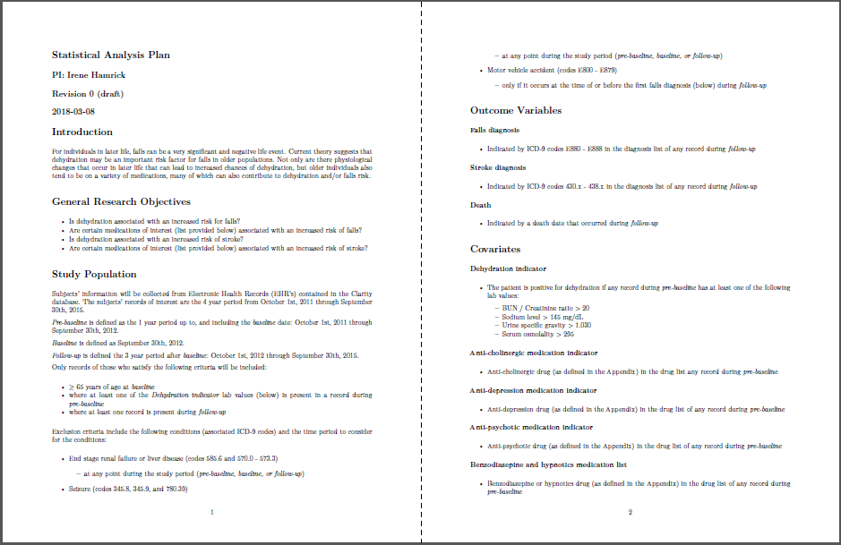
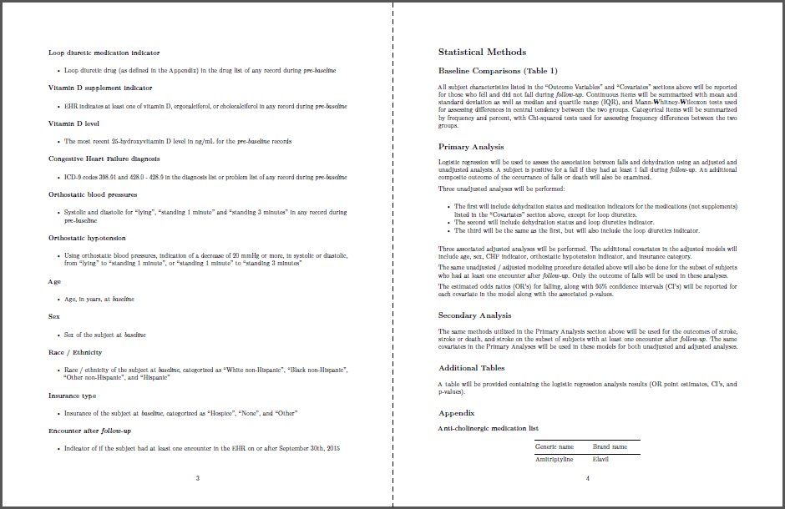
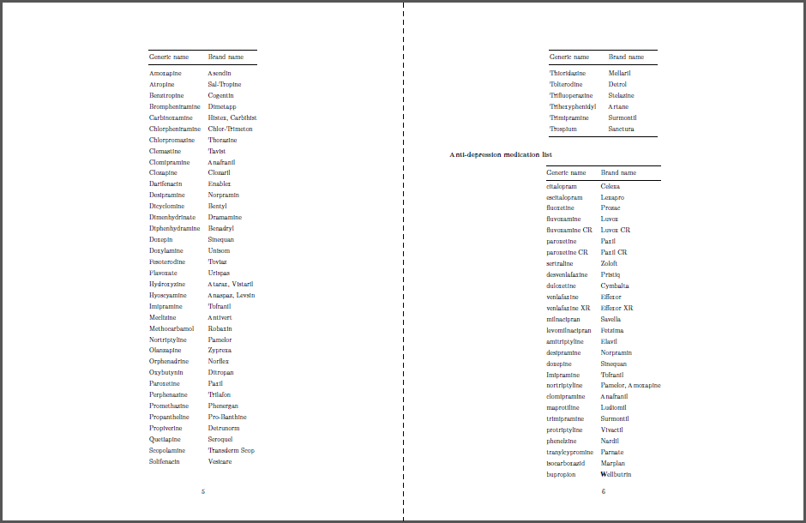
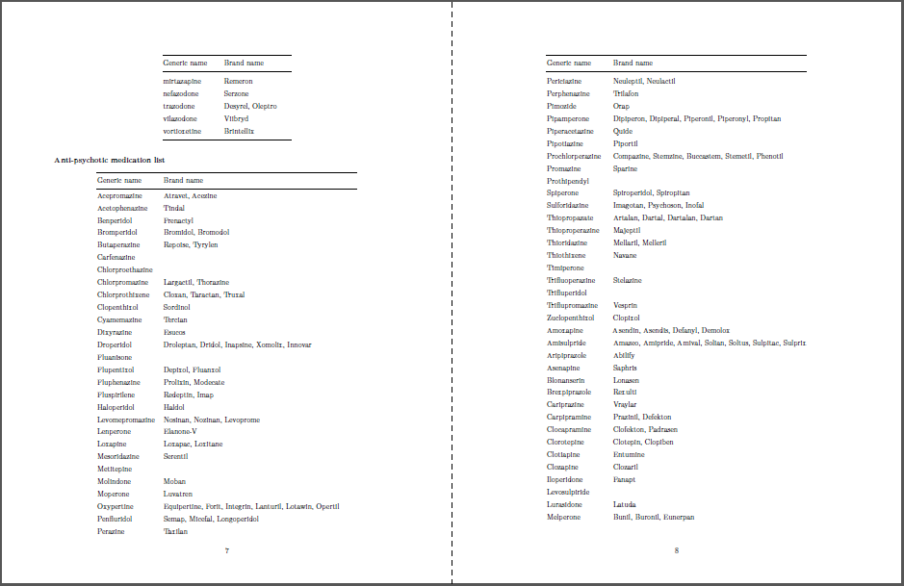
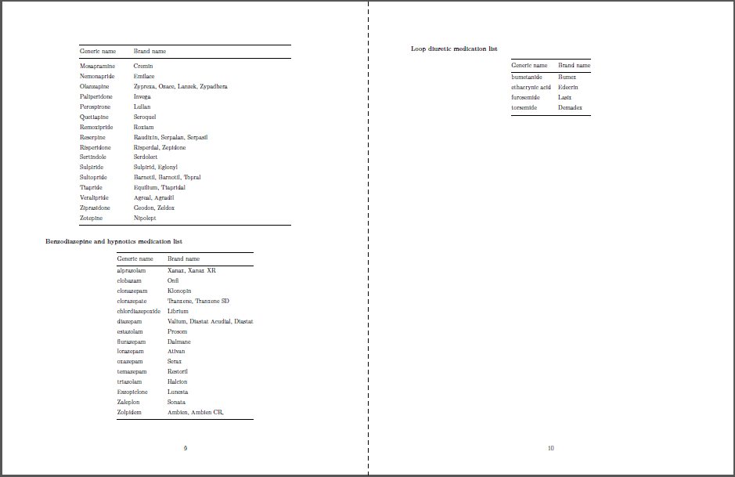
Statistical analysis plan (SAP) structure example
Ideally, the information contained in this document should be discussed and detailed before looking at any data (for as much as that is feasible)

Slide 19

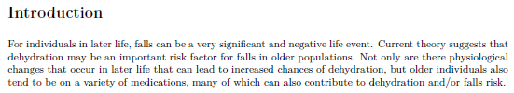
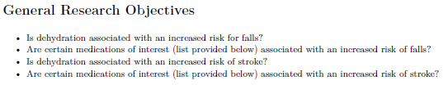
Statistical analysis plan (SAP) structure example
Use some form of header
Dates and versions can be very helpful
Give a brief background and context for the research being done
Clearly state the questions / hypotheses of your research

Slide 20
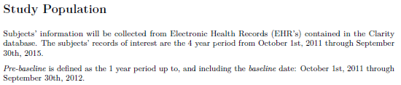
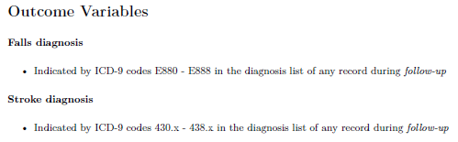
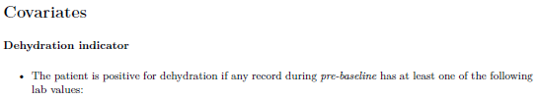
Statistical analysis plan (SAP) structure example
Clearly state where your data is coming from, the target population, and all inclusion exclusion criteria
Clearly state the outcome / response variables of interest, and precisely how you will be defining them…
… and repeat that process for all your covariates / independent variables!

Slide 21
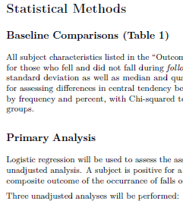
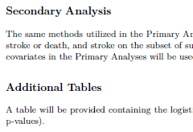
Statistical analysis plan (SAP) structure example
Then, … yep…, “clearly state” what you are going to be doing with the data you just described / defined!
For models, state the entire structure of the model including type of model, dependent variables, all independent variables, interactions, random effects, etc.
(E.g.: Linear mixed effects with the Verbal Learning Factor as the outcome variable; Sex, Age, APOE e4 indicator, and the interaction between Sex and APOE indicator as covariates; person-specific random intercepts and slopes. Fit using REML.)
State the statistic(s) that will be testing your hypotheses.
Include all decision points / rules you’ll be using throughout the process (How will you decide between competing models / covariates? What is the cutoff for a statistically significant finding?)

Slide 22
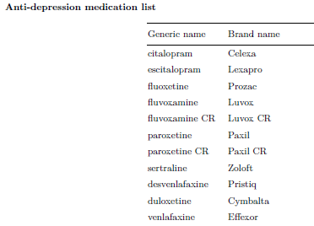
Statistical analysis plan (SAP) structure example
Make sure all relevant information is included for complete understanding and how to execute the plan.
Use appendices or references if needed.
Remember, the purpose of a SAP is clear communication on what will be done.
The science, reasons, and discussion is for the manuscript.
There are no word limits here, so use that freedom to make sure your methods are clear.

Slide 23
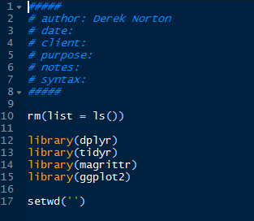
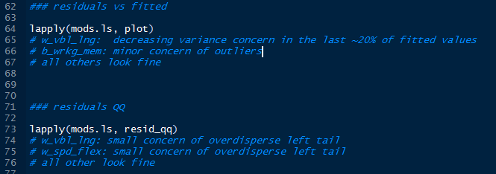
Script structure example
Start developing other standardized / template structures for other aspects of your work, such as the start of scripts!
And use comments liberally!
Use them for section headers, detailing what chunks of code are doing, along with important thoughts and observation!

Slide 24
Suggested Do’s and Don’ts
DO
Break-up major tasks into different scripts, if it make sense for the project
  Import and clean data
  Fit models
  Check model fits
  Make figures
  Make tables
Try and make the next project more reproducible than the last!
As much a priori planning as you can before looking at any data!
DON’T
Use “point and click” methods
  Implies not using Excel
Sacrifice progression for perfection
  “The perfect is the enemy of the good.”
Overwrite an original data extract!
  Always preserve the “most raw form” of the data you have

Slide 25
Additional resources on reproducible research
Karl Broman’s website
  kbroman.org/pages/tutorials.html
  Is a UW Madison BMI professor, and advocate / practitioner of reproducible research
UW Madison course offerings
  Full courses are sometimes available (BMI 826 in the past)
  UW Madison Software and Data Carpentry short courses
    Take place twice a year. Last two days each.
    Unfortunately, URL’s appear tied to the date of courses, so Google is your best resource for finding upcoming courses (or looking at past ones)
Your fellow researchers, collaborators, and mentors!
… and Google…

Slide 26
Multiple comparisons
Erin Jonaitis

Slide 27
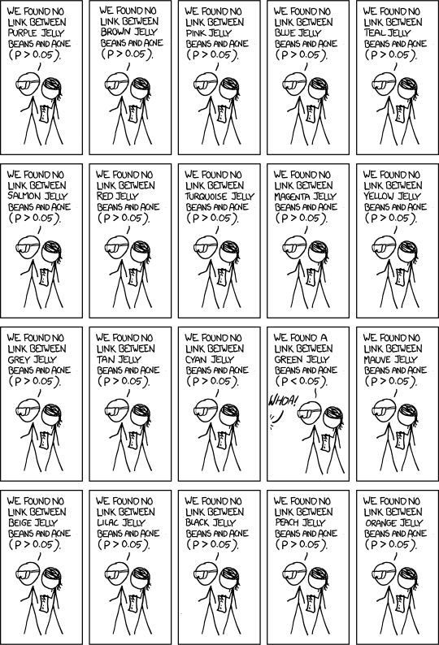
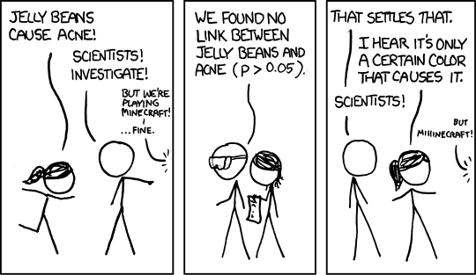
Multiple comparisons
Significant by Randall Munroe, used under CC-BY // format modified to fit screen

Slide 28
Multiple comparisons: Why it matters
Null hypothesis testing is meant to help us avoid wishful thinking
  We build a statistical model of what we would expect if nothing interesting is going on – like flipping a coin a certain number of times
  We compare our data to that model
More tests .= more coin flip experiments
.= more false positives
.= more wishful thinking
.= more wasted time!

Slide 29
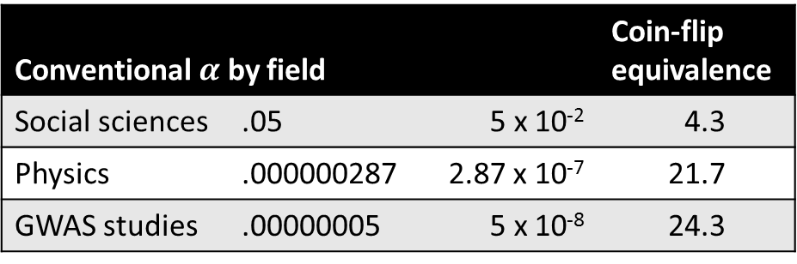

Multiple comparisons: Basic terminology
H₀: the null hypothesis
$m$: the number of comparisons
$α$: the threshold for rejecting H₀
Conventional $α$ by field |  |  | Coin-flip equivalence
Social sciences | .05 | 5 x 10⁻² | 4.3
Physics | .000000287 | 2.87 x 10⁻⁷ | 21.7
GWAS studies | .00000005 | 5 x 10⁻⁸ | 24.3

Slide 30
Multiple comparisons: Some options
Familywise error rate (FWER):
probability of making at least one Type I error, assuming H₀ is true
False discovery rate (FDR):
expected proportion of Type I errors, assuming H₀ is true
Which approach to use?
  Controlling FWER is more conservative, and less powerful
  What are the costs of being wrong?

Slide 31
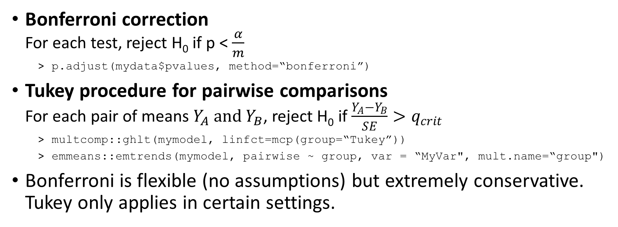
Multiple comparisons: FWER (single-step)
Bonferroni correction
For each test, reject H₀ if p < $\frac{α}{m}$
  p.adjust(mydata$pvalues, method=“bonferroni”)
Tukey procedure for pairwise comparisons
For each pair of means $Y_{A} and$ $Y_{B}$, reject H₀ if $\frac{Y_{A}−Y_{B}}{SE}>q_{crit}$
  multcomp::ghlt(mymodel, linfct=mcp(group=“Tukey”))
  emmeans::emtrends(mymodel, pairwise ~ group, var = “MyVar", mult.name=“group")
Bonferroni is flexible (no assumptions) but extremely conservative.
Tukey only applies in certain settings.

Slide 32
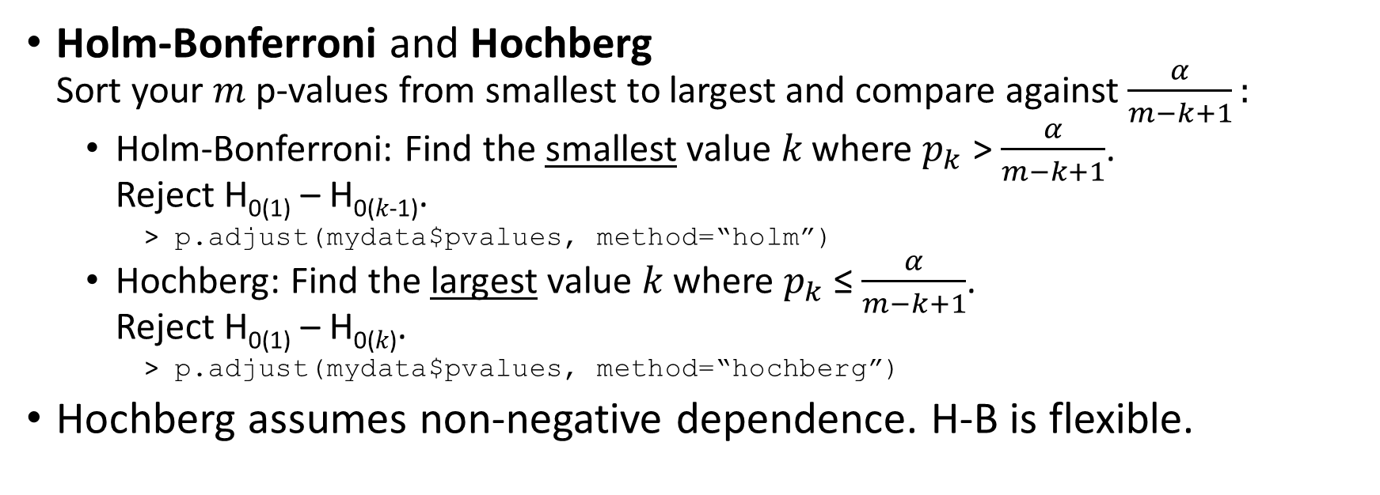
Multiple comparisons: FWER (sequential)
Holm-Bonferroni and Hochberg
Sort your $m$ p-values from smallest to largest and compare against $\frac{α}{m−k+1}:$
  Holm-Bonferroni: Find the smallest value 𝑘 where $p_{k}$ > $\frac{α}{m−k+1}$.
  Reject H₀₍₁₎ – H_{0(𝑘-1)}.
    p.adjust(mydata$pvalues, method=“holm”)
  Hochberg: Find the largest value 𝑘 where $p_{k}$ ≤ $\frac{α}{m−k+1}$.
  Reject H₀₍₁₎ – H_{0(𝑘)}.
    p.adjust(mydata$pvalues, method=“hochberg”)
Hochberg assumes non-negative dependence. H-B is flexible.

Slide 33
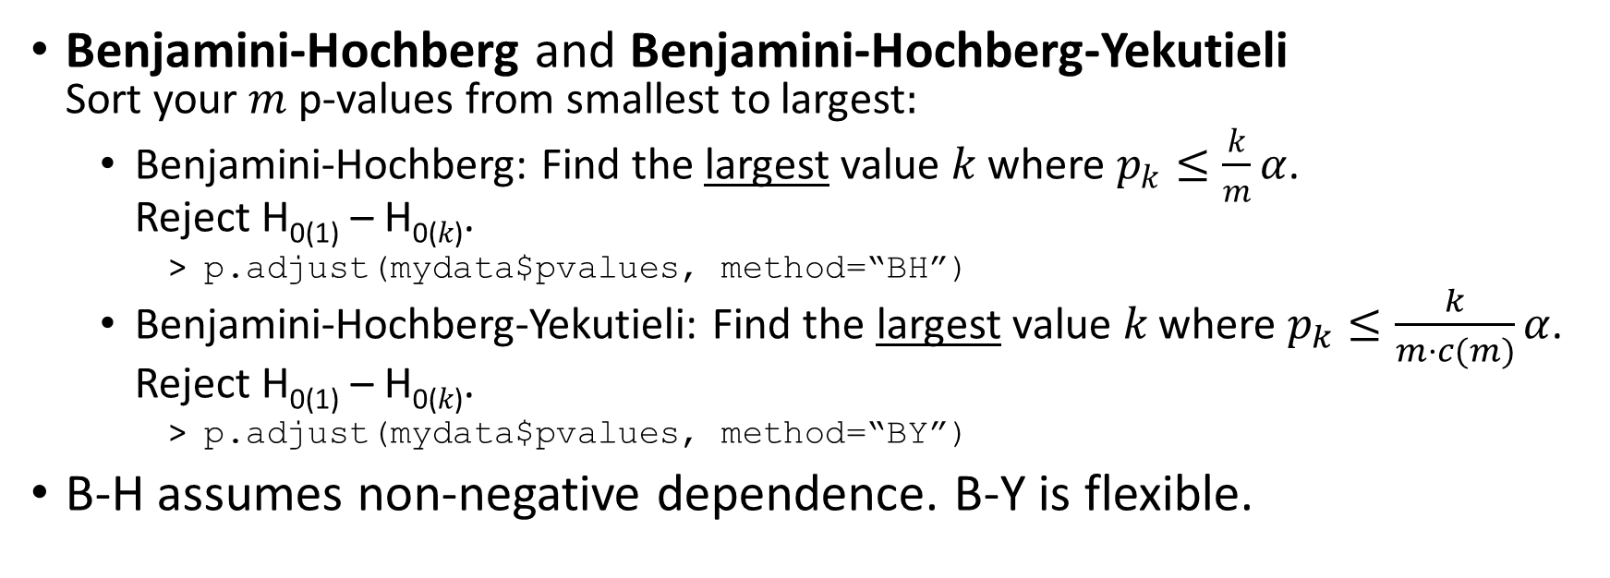
Multiple comparisons: FDR procedures
Benjamini-Hochberg and Benjamini-Hochberg-Yekutieli
Sort your $m$ p-values from smallest to largest$:$
  Benjamini-Hochberg: Find the largest value 𝑘 where $p_{k}≤\frac{k}{m}α$.
  Reject H₀₍₁₎ – H_{0(𝑘)}.
    p.adjust(mydata$pvalues, method=“BH”)
  Benjamini-Hochberg-Yekutieli: Find the largest value 𝑘 where $p_{k}≤\frac{k}{m·c(m)}α$.
  Reject H₀₍₁₎ – H_{0(𝑘)}.
    p.adjust(mydata$pvalues, method=“BY”)
B-H assumes non-negative dependence. B-Y is flexible.

Slide 34
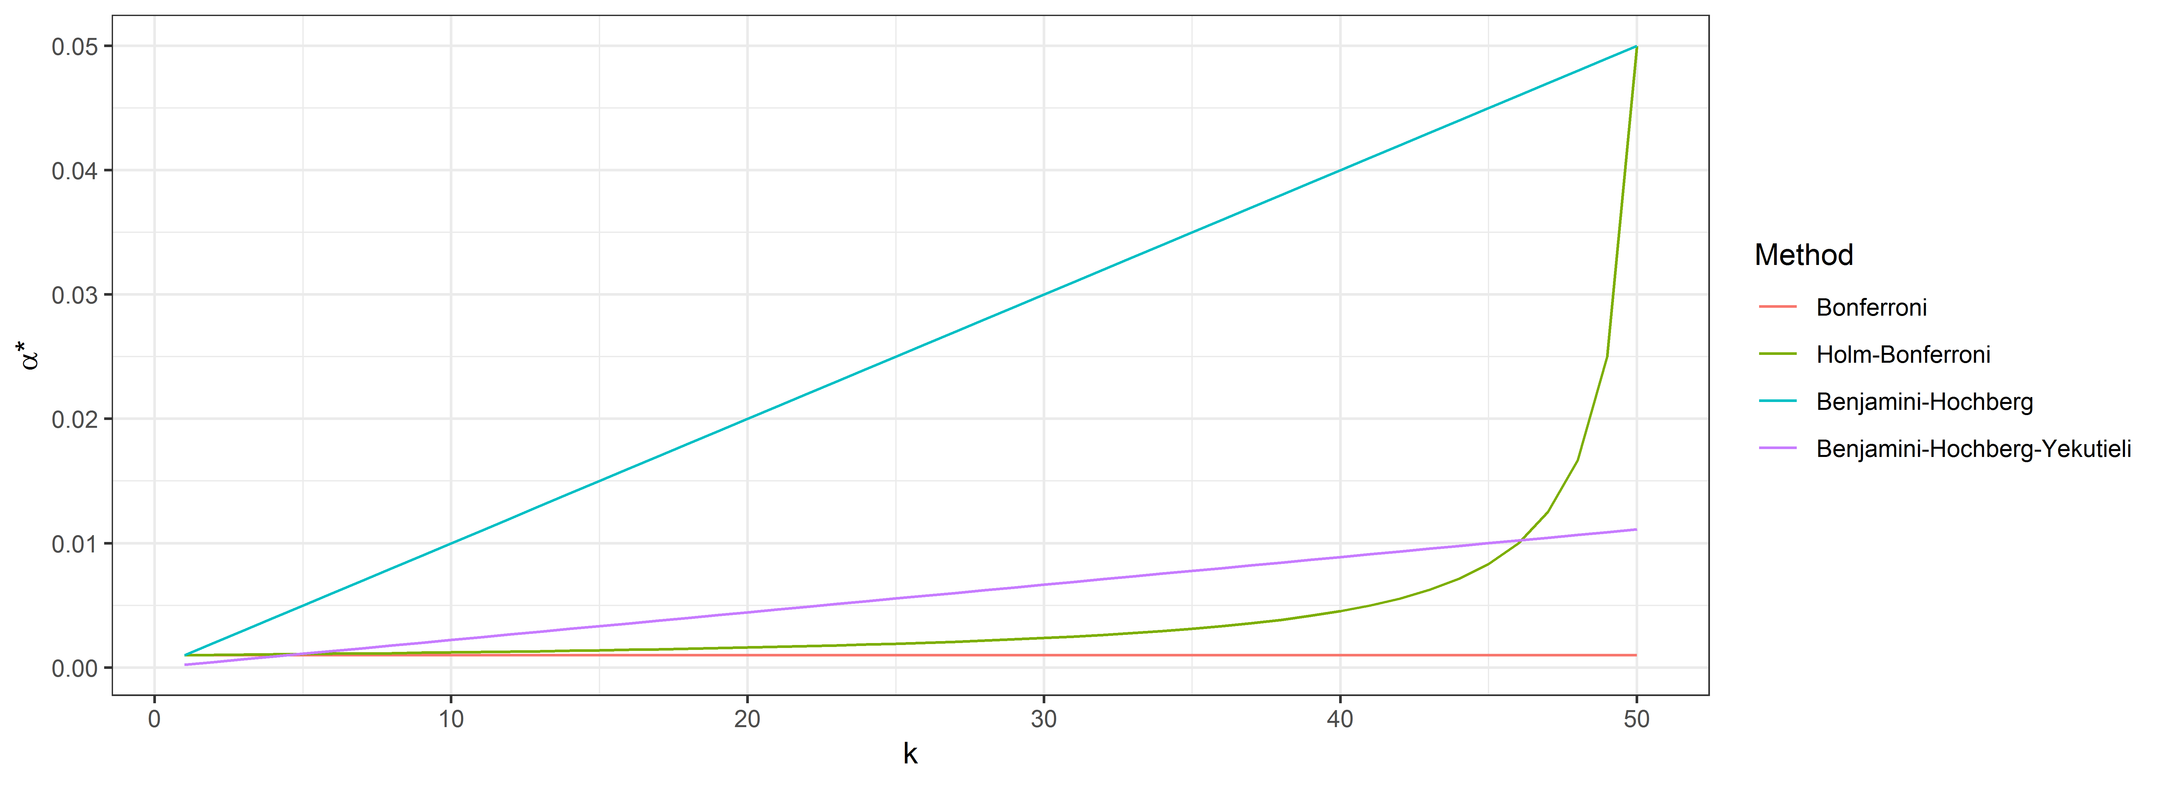
Multiple comparisons:
Comparing sequential procedures

Slide 35
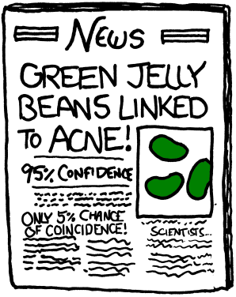
Multiple comparisons: The bottom line
Make a plan
Lots of tools are available!
Ask for help if you need it.
Be transparent
Tell the audience what you did.
Be humble
You’re still going to be wrong a bunch.
Don’t oversell it.

Slide 36
Three practices to avoid
Yue Ma

Slide 37
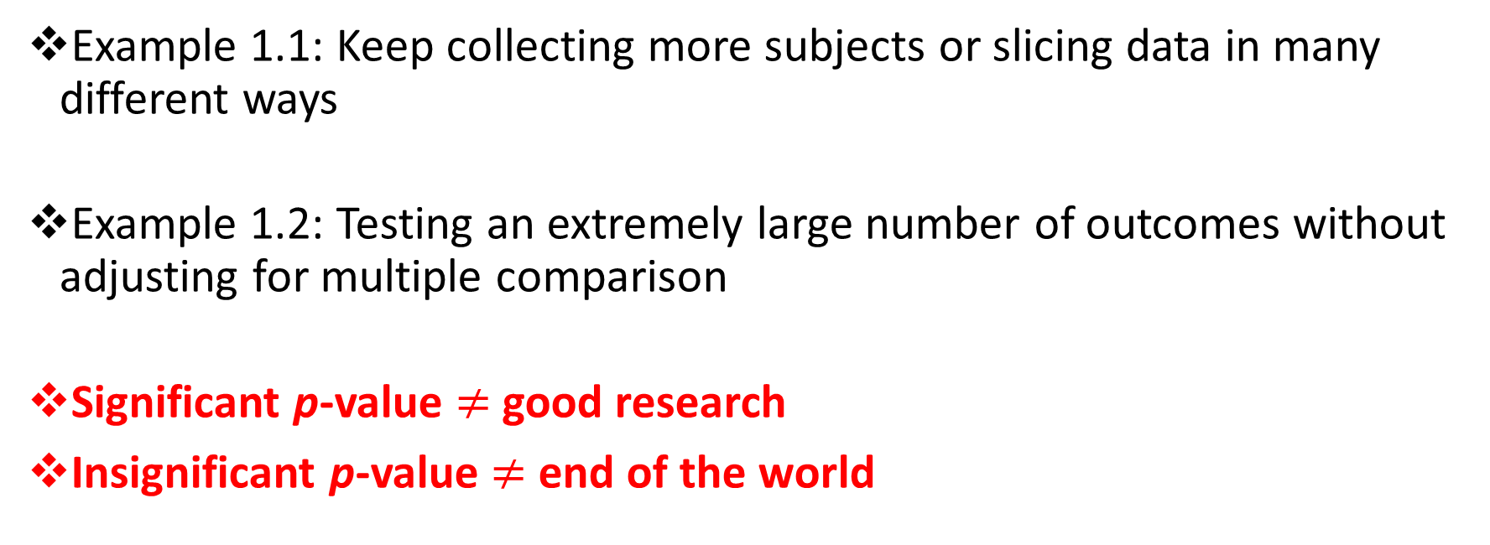
To Avoid: Fishing P-Values
Example 1.1: Keep collecting more subjects or slicing data in many different ways
Example 1.2: Testing an extremely large number of outcomes without adjusting for multiple comparison
Significant p-value $≠$ good research
Insignificant p-value $≠$ end of the world
Notes:
I have seen research projects published without significance, won an award without significance

Slide 38
How To Avoid: Fishing P-Values
Insignificance is a finding
Look at effect size in terms of clinical meanings
Why is it not significant?
- Clinical explanations?
- Effect size?
- Sample size?
- Sample characteristics?
- Measurement reliability?
Any accomplishments in your study?
- Asked a new research question?
- Applied to participants with specific characteristics?
- Adopted an innovative methodology?
Future Directions

Slide 39
To Avoid:
Copying a Statistical Method without Understanding
Example 2: Copy a statistical method from another study without understanding
  The type of research question the method is aimed to answer
  The type of data the method is applicable to
Draw a tiger after the model of a cat
  Copy something without catching its true spirit
Notes:
Copy or imitate something that appears to be similar, without understanding and catching its true spirit

Slide 40
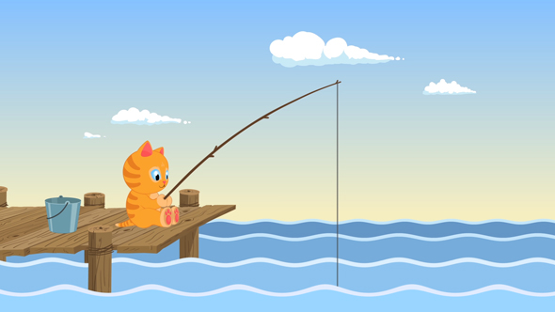
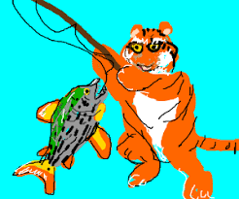
To Avoid:
Copying a Statistical Method without Understanding
I am fishing p-values in the data ocean.
Me Too!
p < .05
p < .05

Slide 41
How To Avoid:
Copying a Statistical Method without Understanding
Formulate the research questions
Translate the questions into testable hypotheses, i.e., can be expressed with math
“Only if a field of science can be expressed with math, it is truly a science.”
Only if a research question can be translated into testable hypothesis, it is a good research question.

Slide 42
How To Avoid:
Copying a Statistical Method without Understanding
Understand the data (especially the outcome variables)
Distinguish the four different types of variables:
nominal, ordinal, interval, and scale
Understand the specific characteristics of the data
  e.g., longitudinal
  e.g., clustered
  e.g., censored
  e.g., types of missing data
Notes:
Understand the data
especially the distribution of the outcome

Slide 43
How To Avoid:
Copying a Statistical Method without Understanding
Based on understanding both, choose the statistical methods that fit the specific research questions and the specific data
Make the outfit for the specific body figure
Prescribe the medication to the specific disease
Notes:
Understand the data
especially the distribution of the outcome

Slide 44

To Avoid:
Underestimating Data Management
Good quality data is the foundation for valid statistical analysis
Ground foundation for statistical skyscrapers
Example 3: Data errors in the data set the analyses started on led to redo the analyses
Notes:
Ground foundation for building a skyscraper

Slide 45
How To Avoid:
Underestimating Data Management
Read and understand data dictionaries, survey forms, and documentation about data collection and scoring methods
e.g., A category changes its meaning from one form version to another
e.g., Removal of a category in a later version

Slide 46
How To Avoid:
Underestimating Data Management
Data Checking
Category
Range

Slide 47
How To Avoid:
Underestimating Data Management
Data manipulation specific to analysis needs
Select observations (participants, visits)
Select variables
Derive new variables
Restructure data
Merge multiple data sets

Slide 48
How To Avoid:
Underestimating Data Management
Plan enough time and effort
Data management takes more time than statistical analysis
Start early

Slide 49
How To Avoid:
Underestimating Data Management
Documentation
What has been done to the data
How the different data sets are created and changed from one to another
Dates, versions, names
Help with valid & efficient analysis
Facilitate team work, multi-center collaboration, and reproducibility
Notes:
Going back as needed, e.g., rescoring data based on updated scoring algorithm or reviewers’ feedbacks.
Hopefully these suggestions can be helpful with your research.

Slide 50
Case study: SHARP
(Statins in Healthy, At Risk Adults: Impact on Amyloid and Regional Perfusion)
Principal Investigator: Cynthia Carlsson, MD
Rick Chappell

Slide 51
Case study: SHARP
Materials:
SHARP Protocol
SHARP Statistical Analysis Plan
Dr. Carlsson’s study rationale slides
Key Words: Endpoints, Normalized endpoints, Surrogate outcomes, multiplicity

Slide 52
Case study: SHARP protocol
Rationale: Hypercholesterolemia in midlife increases the risk of developing Alzheimer disease (AD) decades later, possibly via its negative effects on β -amyloid (Aβ) metabolism and cerebrovascular dysfunction. Both Aβ deposition in the brain and cerebrovascular dysregulation are two early findings in preclinical AD pathology and work synergistically to accelerate neuronal degeneration. Thus, therapeutic interventions that both reduce Aβ levels and improve cerebral blood flow (CBF) may interrupt this cascade effect to delay the development of AD pathology.
In epidemiologic studies treatment with cholesterol-lowering medications, specifically statins, is associated with up to a 73% reduction in the prevalence of AD, suggesting a potentially promising role for statins in AD prevention.

Slide 53
Case study: SHARP protocol
Hypotheses: … in middle-aged, non-demented, adult children … of persons with AD, long-term simvastatin therapy will beneficially affect two mechanisms central to AD pathology by:
1) lowering CSF Aβ levels, and
2) improving CBF.

Slide 54
Case study: SHARP protocol
Specific Aims:
To determine the effects of 18 months of simvastatin therapy on CSF levels of … Aβ₄₂ in non-demented adult children of persons with AD when compared to subjects taking placebo.
To determine … on other CSF biomarkers related to AD progression, including Aβ₄₀, Aβ peptide fragments, … t-tau, p-tau, and novel … SELDI-TOF biomarkers in non-demented adult children of persons with AD when compared to subjects taking placebo.
To evaluate … on quantitative CBF as measured by ASL-MRI.
To investigate the effect of duration of simvastatin therapy on CSF and CBF at 6, 12, and 18 months.
To understand the relationship of changes in primary and secondary outcome measures (CSF biomarkers and qASL-MRI) with changes in cognition.

Slide 55
Case study: SHARP Statistical Analysis Plan
Thought experiment - count the number of specific outcomes listed in the SAP.
Main categories are:
  CSF protein biomarkers
  Cerebral blood flow
  Cognitive outcomes
Measures are taken at 0, 12, 18, and sometimes 6 months.
We can look at absolute measures or change from baseline.
Besides standardizing by baseline, CBF can be anatomically standardized.
There are no major safety endpoints. Why?

Slide 56
Case study: SHARP Statistical Analysis Plan
Sub-categories are:
  For CSF, Protein biomarkers:
    Primary outcome Aβ42 at 18 vs. 0 months
    Many secondary outcomes – see SAP
  For cerebral blood flow, Regions:
    Whole brain
    ​Pre-defined “Statistical region of interest”
    Many cerebral regions – see SAP
  For cognitive outcomes, Domains:
    Memory / Learning
    Complex attention
    Language
    Working Memory

Slide 57
Case study: Digression
How do we standardize cerebral blood flow?
E.g., for the angular gyrii (one on each side)
  Can divide an angular gyrus’ blood flow by whole brain blood flow, but this includes the angular gyrii plus nearby regions
  Can divide an angular gyrus’ blood flow by that from a distant region such as cerebellum.

Slide 58
Case study: Digression
How do we standardize cerebral blood flow?
E.g., for the angular gyrii (one on each side)
  Do we want to?
  What if simvastatin uniformly increases cerebral blood flow regardless of region. Is there anything wrong with that?
  (end digression)

Slide 59
Case study: SHARP Statistical Analysis Plan
Sub-sub-categories are:
  For CSF:
    For some proteins, choice of assay – MSD Triplex vs. xMAP.
  For cerebral blood flow:
    Standardized vs. un-standardized.
  For cognitive outcomes:
    Each domain can be evaluated using a choice of many instruments
    In turn, each instrument can incorporate many individual questions or tasks (sub-sub-sub categories?)

Slide 60
Case study: SHARP Statistical Analysis Plan
Main points:
  The boundary between a surrogate and a clinically meaningful outcome may be vague
    On which side do cognitive tests in SHARP fall?
    Is blood flow strictly a surrogate?
  Especially for early-phase trials there may be a profusion of outcomes in a variety of general rubrics (here: CSF protein markers; cerebral blood flow; and cognitive measures).
  Even within endpoints there may be a choice of using one or more measurement times; a choice of assays, and choice of standardization.

Slide 61
Summary/Conclusions
p<0.05 does not automatically mean the analysis or conclusions are correct!
There are many factors to consider that contribute to completion of a high quality research project.
Consulting with one of your local statisticians throughout your research process could easily make your life earlier in both the short and the long run.
Please, start early in your collaborations (i.e., long before your abstract is due or your manuscript is “ready” to submit)

Slide 62
Misc. Resources
For researchers in the ADRC requesting consultative services:
https://redcap.ictr.wisc.edu/surveys/?s=NpdS3Ve9gR

Slide 63
Misc. Resources
For researchers in the SMPH not associated with the ADRC: https://ictr.wisc.edu/consults/biostatistics-2/
The Clinical Trials Accelerator is a service will support investigators who are new to developing clinical trials. Anticipated ICTR resources available to investigators include protocol and budget development, regulatory & compliance consultations, IND/IDE assistance, biostatistics consultations, data management solutions and targeted recruitment support. Where appropriate, junior faculty will work with a Clinical Trial Coach to launch and conduct their study (ctaccelerator@lists.wisc.edu).

Slide 64
Additional Resources
“The Analysis Factor” … loads of clear explanations of statistical concepts, free webinars, and other info: https://www.theanalysisfactor.com/
UCLA Institute for Digital Research and Education (“IDRE”)…lots of advice related to a variety of stats packages: https://idre.ucla.edu/
Penn State... Great online stats materials: https://newonlinecourses.science.psu.edu/statprogram/

Slide 65
Additional Resources (Derek's list earlier)
Karl Broman’s website: kbroman.org/pages/tutorials.html
(Dr. Broman is a UW Madison BMI professor, and advocate / practitioner of reproducible research
UW Madison Software and Data Carpentry short courses: take place twice a year and last two days each. (Google phrase like "UW Data Carpentry" is your best resource for finding upcoming courses (or looking at past ones))

Slide 66
Additional Resources related to SAPs
Derek provided an example SAP and the article corresponding to it
Rebecca added a couple SAP articles.
(Sam will send these along with the slide presentation)

Slide 67

Thank you!

